Slide 1
Project1 – Food Access Correlation
Team Pandamonium
Candace C., Kelly W., Keaton B.,
Marvin A., Amol G.
February 1, 2020
Notes:
Candace

Slide 2
Hypothesis
Do you live in a food desert?
In this project we evaluated three potential factors that affect people’s access to food. For this,we will define access as the number of people in a county living more than one mile from a supermarket or large grocery store in an urban area or more than ten miles for rural areas. Our data is based on the estimated population and actual data from 2015.
Factors:
Population Density
Education
Median Household Income
Questions:
Do any of these factors affect access to healthy food?
Which factor(s) is/are most significant?
Do these results vary by region?
Notes:
Candace

Slide 3
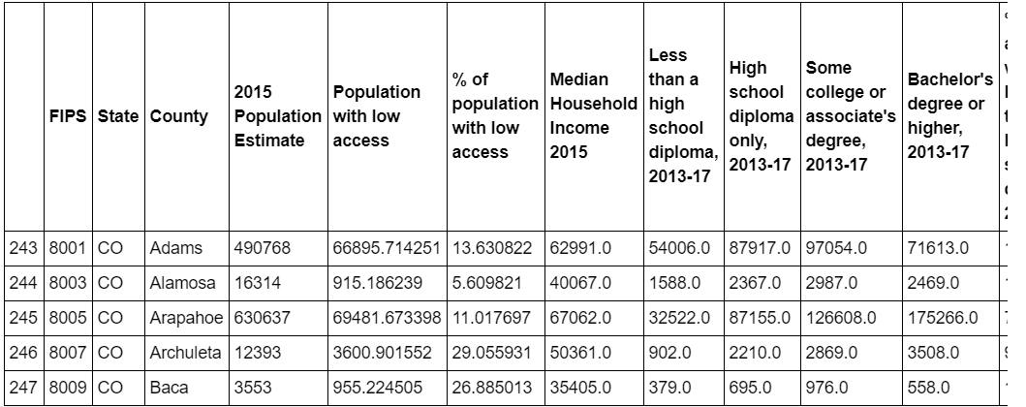
Data Exploration/Cleanup
Data obtained through Kaggle.com and data.gov. We used information from an environmental atlas study which resulted in an access score by county as the basis of our analysis. Next, we have population and education data obtained at a county level.
The data was housed in 3 separate excel spreadsheets which were trimmed, renamed, and merged to form one dataset that could be analyzed as a whole or selectively by state.
Jupyter Notebook - Data Cleanup
Notes:
Candace

Slide 4
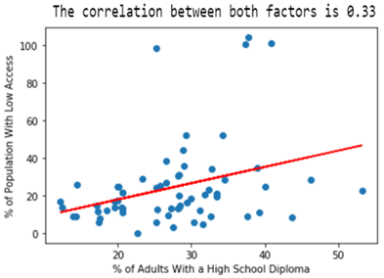
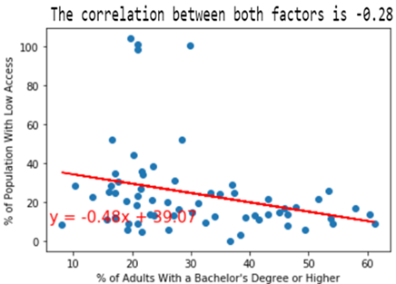
Education - CO
Having a high school diploma is weakly associated with having low access to food.
This group may have higher incomes that allow them more choice in housing.
Having a bachelor’s degree or higher is weakly associated with high access to food.
Highly educated people likely can afford high quality housing with nearby amenities.
Notes:
Kelly

Slide 5
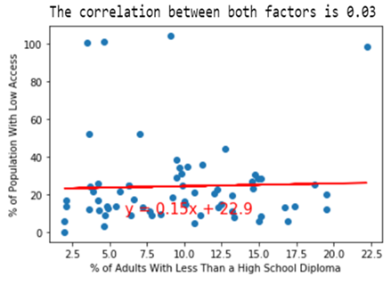
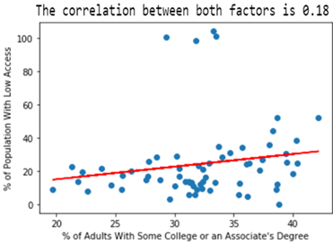
Education - CO
Less Than a High School Diploma and Some Secondary Education are not correlated.
Those with lower education can probably only afford housing in more urban areas, close to food sources.
Outliers:
May be households in remote areas.
Notes:
Kelly

Slide 6

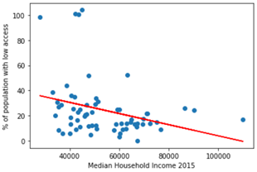
Income - CO
Correlated data analysis of Median Household Income and access to food options.
With this negative correlation we could deduce that as the average income increases the % of population with low access to good food reduces.
Notes:
Amol

Slide 7
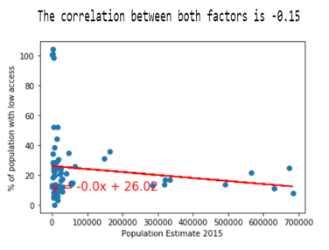
Population - CO
Correlated data analysis of Low Food access and Population Density .
The correlation between both factors is -0.15. This negative correlation indicated there is a weak influence of population density with low access food.
Notes:
Marvin

Slide 8
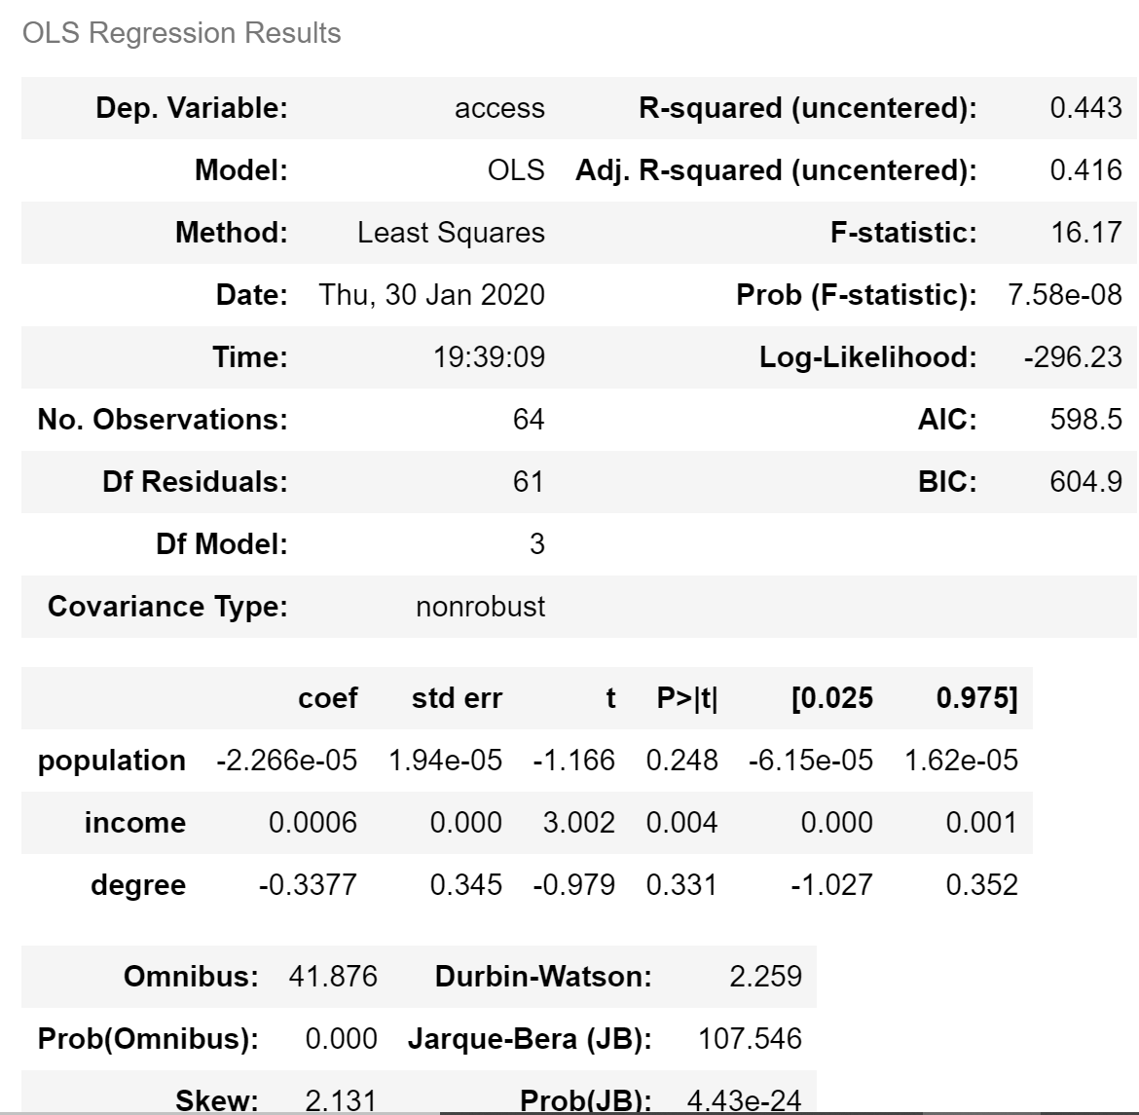
Multivariate Analysis - CO
FoodAccess = β₀ + β₁populationᵢ + β₂educationᵢ + β₃incomeᵢ + ԑᵢ
R-squared: 0.44
Median Income is statistically significant at the p = 0.05 level.
(Link to Jupyter Notebook)
Notes:
Keaton

Slide 9
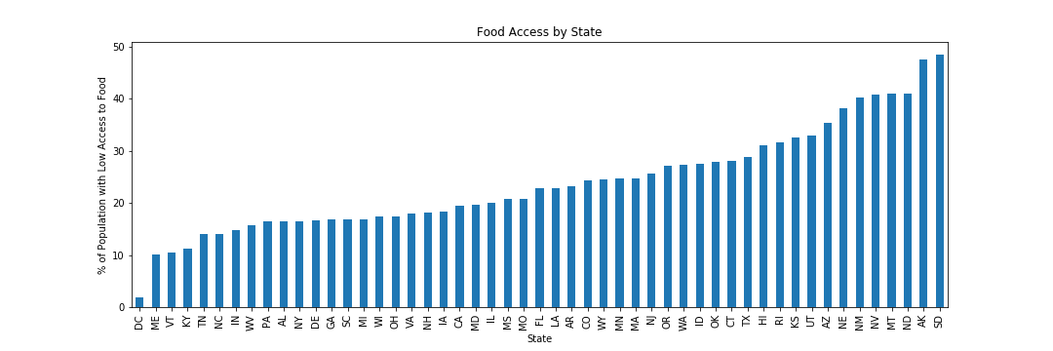
Food Access by State
Notes:
Keaton

Slide 10
Comparing Regions: California & Alabama
Alabama:
Population/Access: 0.22
Income/Access: -0.12
Education/Access: 0.26
California
Population/Access: -0.26
Income/Access: -0.29
Education/Access: -0.28
Conclusions:
Our hypotheses potentially differ by region.
Notes:
Marvin

Slide 11
Conclusions
Do any of these factors affect access to healthy food?
All three factors were moderately correlated for Colorado.
Which factor(s) is/are most significant?
The most statistically relevant factor is median income for the state of Colorado.
Do these results vary by region?
Yes, we see different results, but did not have time to properly analyze why.
Notes:
Kelly
Median income has a p-value of 0.004

Slide 12
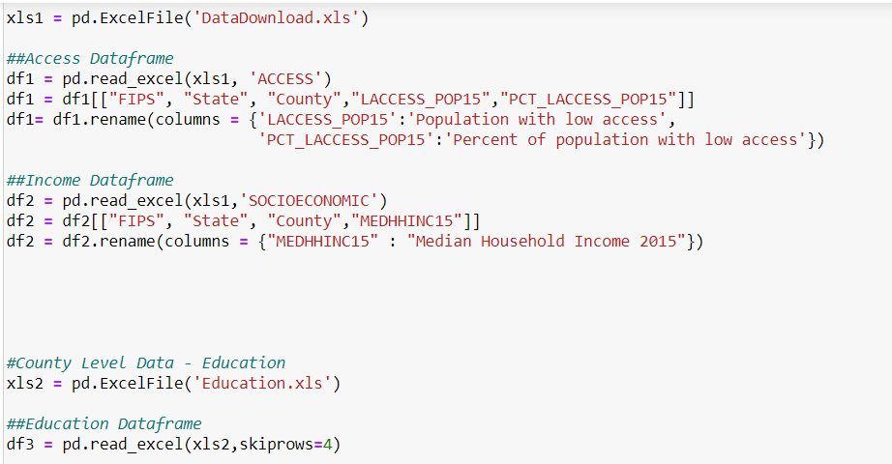
Additional Struggles
Reading from an .xls file with multiple tabs that is too large to be converted to .csv
Notes:
Candace

Slide 13
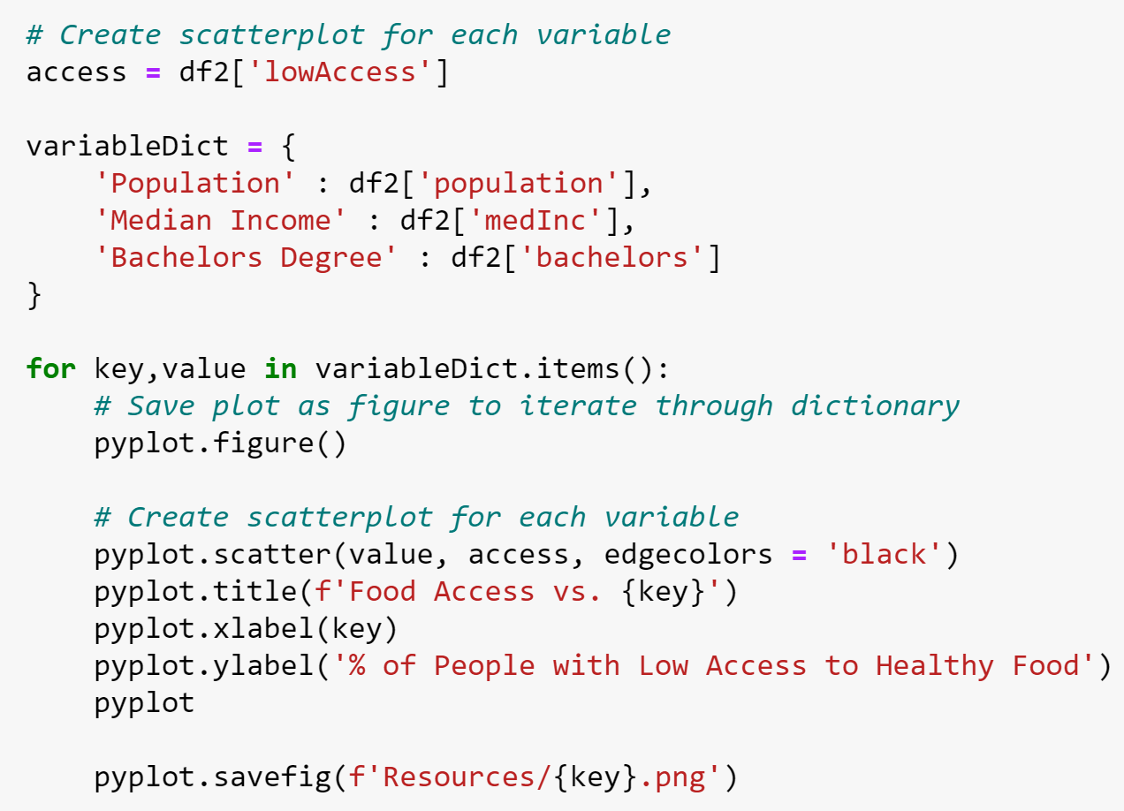
Additional Struggles
Creating a function to loop through dictionary and create plots
Notes:
Keaton

Slide 14
What would you look at if you had more time?
Analyze all states, and potentially by region
What factors differ and why?
Are their regional trends?
Analyze counties from different regions with similar population densities.
Are people utilizing their access to purchase healthier options?
Notes:
Amol

Slide 15
Resources / Links
•Food environment atlas study - https://www.kaggle.com/carrie1/food-environment-atlas
•County level data study (education and population) - https://www.ers.usda.gov/data-products/county-level-data-sets/download-data/

